Slide 1

Summerprogram
2020 in Germany
Wilhelmshaven, summer 2019

Slide 2





cooperation
1987 - 2019
… very intensive with summerprograms and projects since 2012!
2
2
2

Slide 3
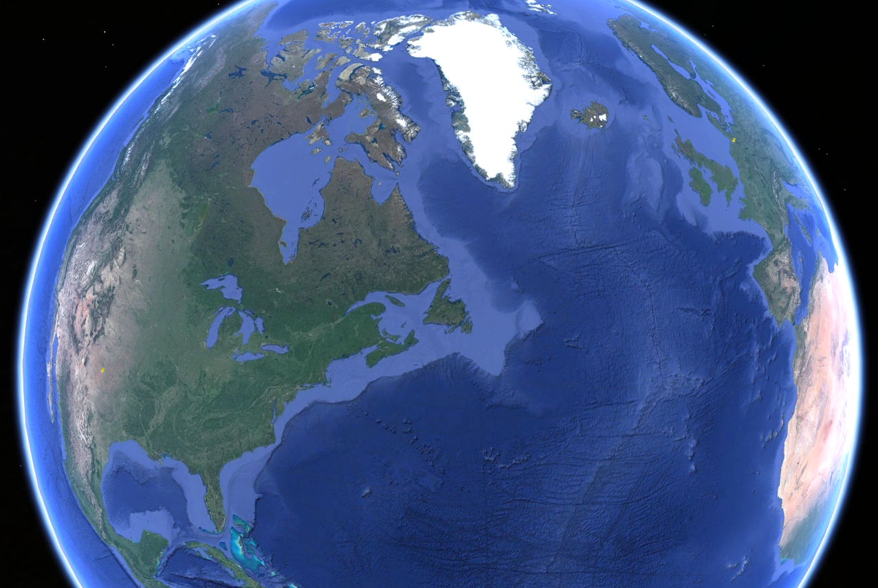
come to Germany
From USA - Texas- Lubbock to Europe - Germany - Wilhelmshaven

Slide 4
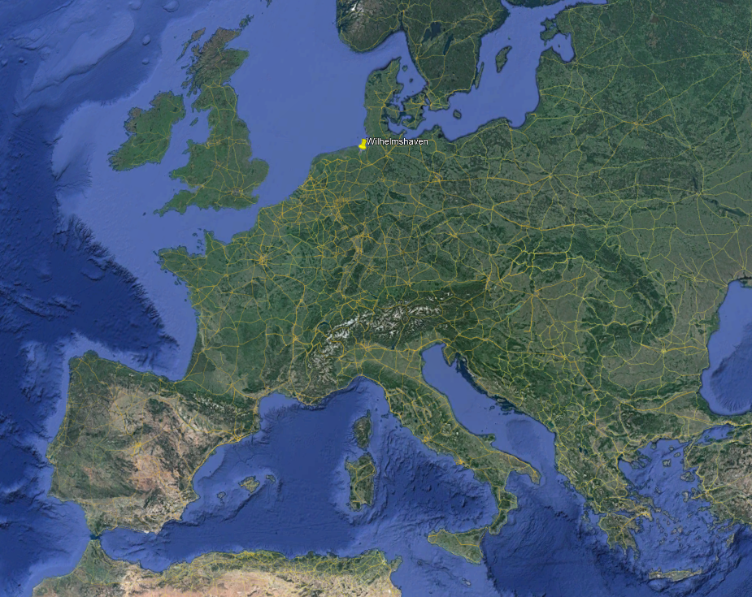
come to Germany
Europe - Germany - Wilhelmshaven

Slide 5
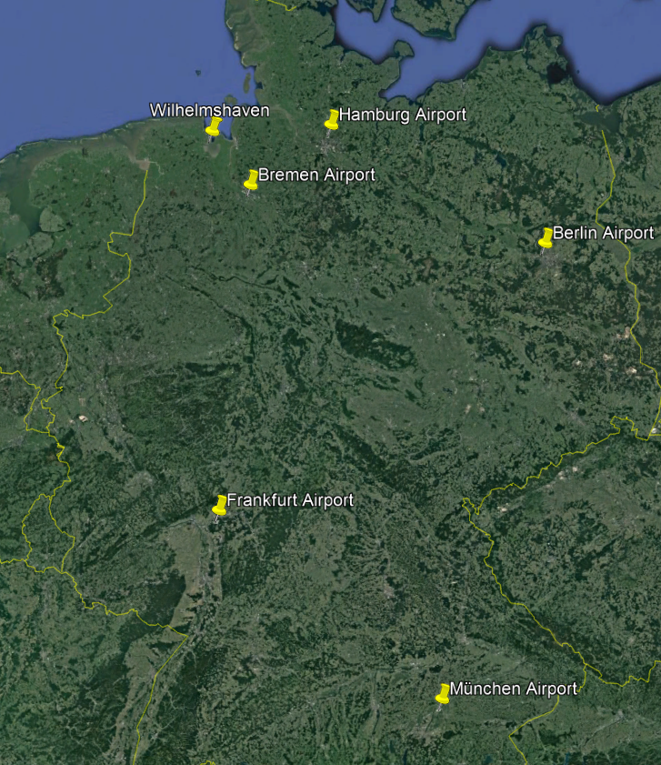
come to Germany
Germany - Wilhelmshaven

Slide 6
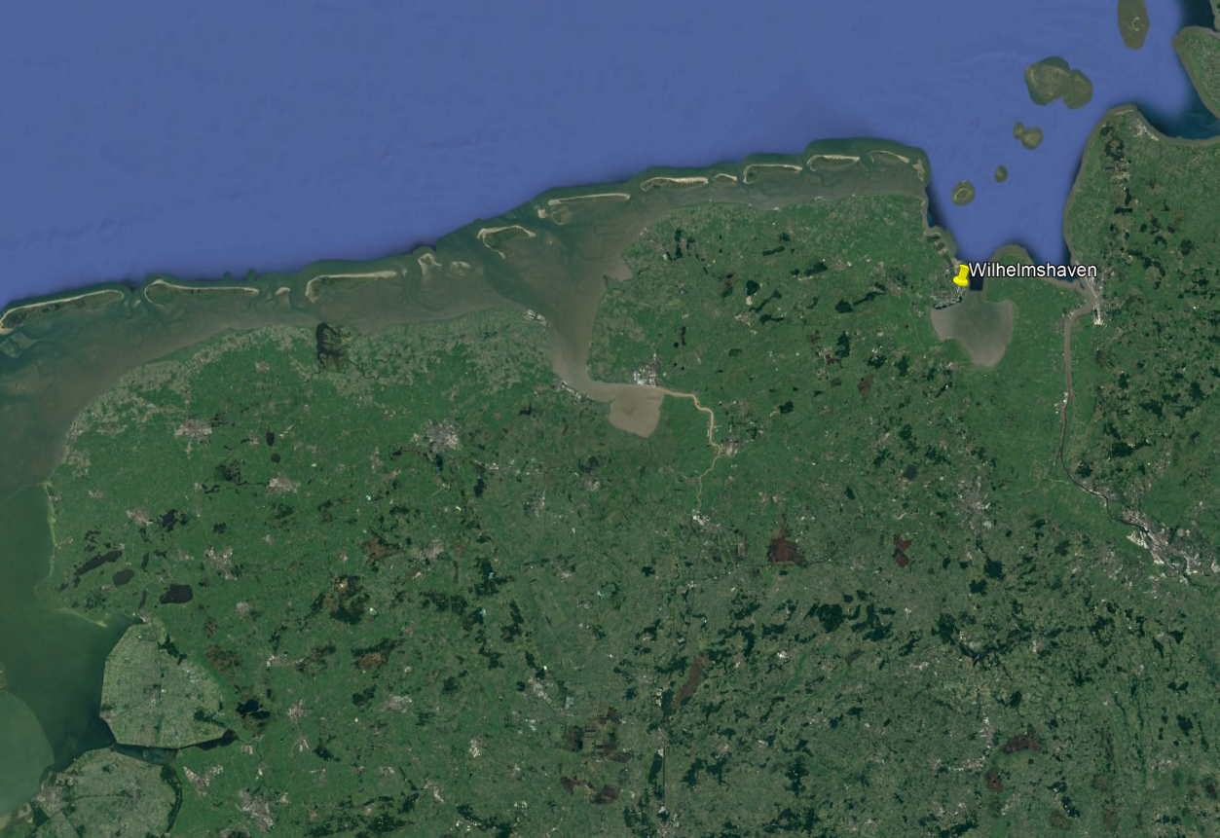
come to Germany
Wilhelmshaven

Slide 7
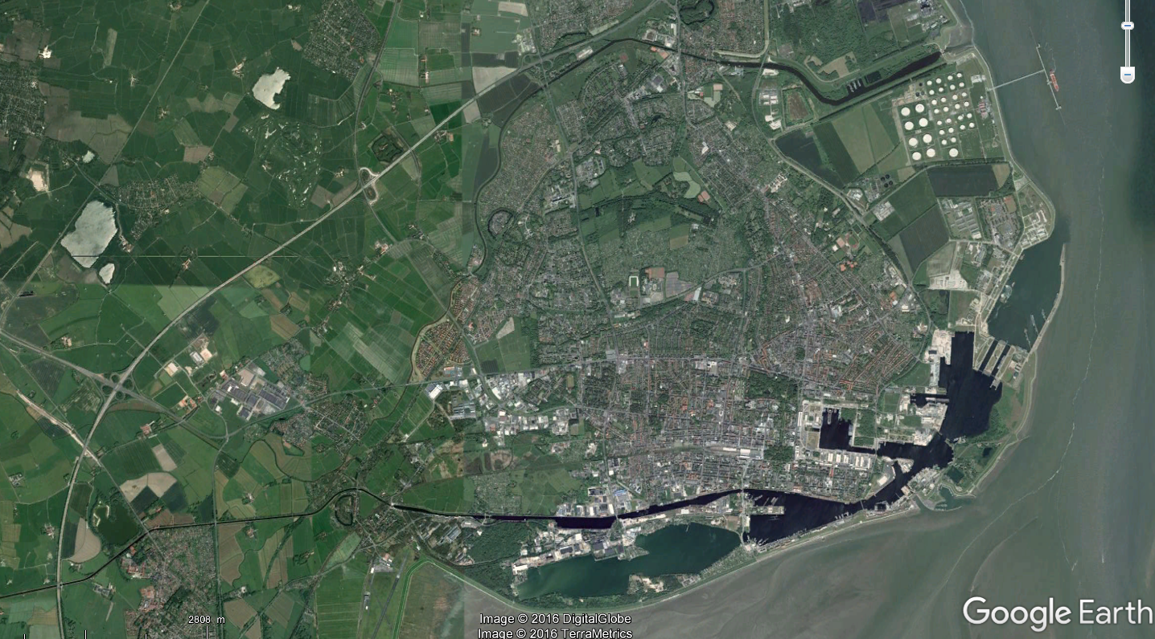



wilhelmshaven
Downtown – Hotel Campus
7
7
7

Slide 8
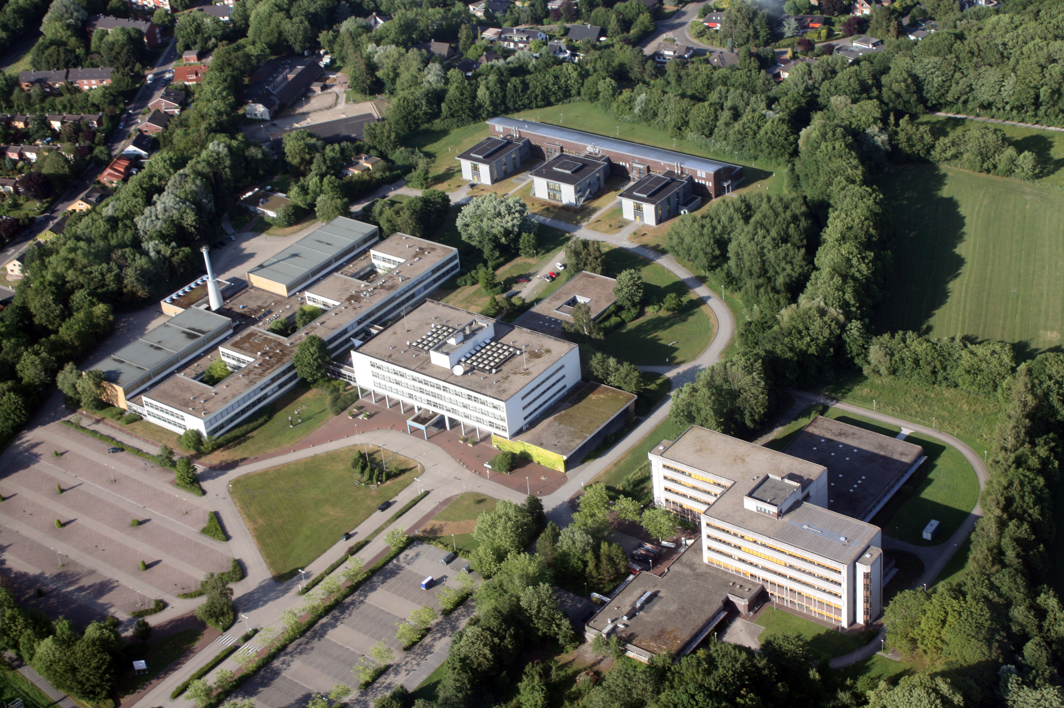

Campus Birdview
www.jade-hs.de
Foto: Lübben
8
8
8

Slide 9
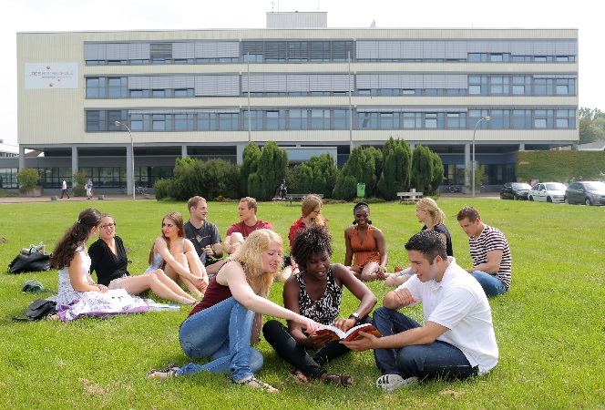
Campus mainbuilding

Slide 10
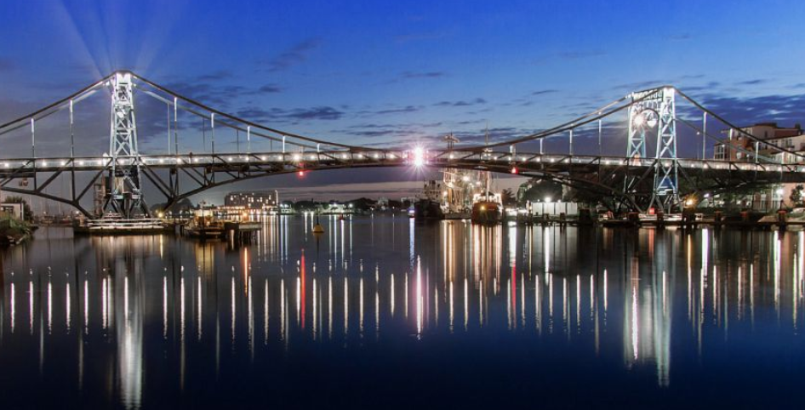
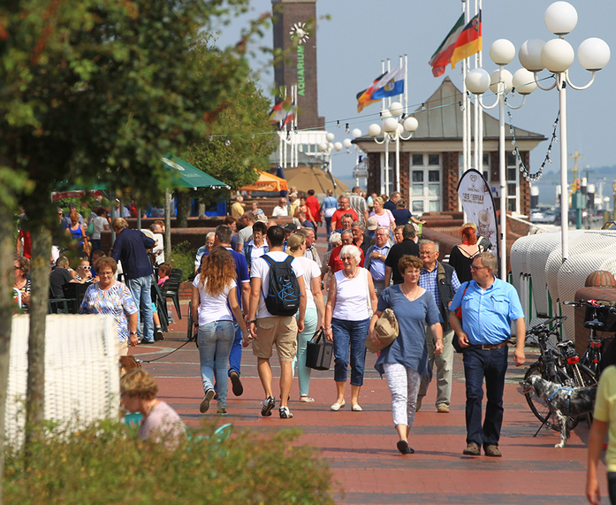
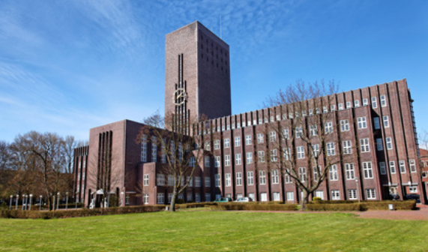
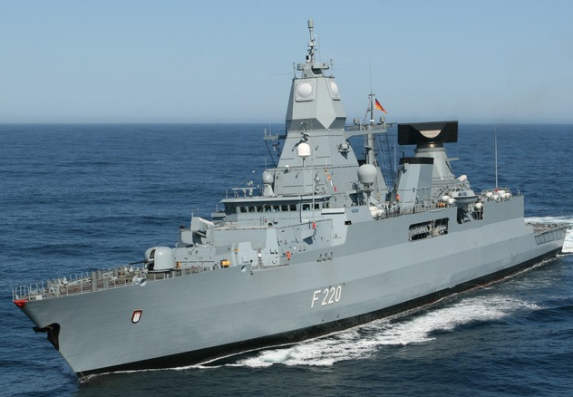
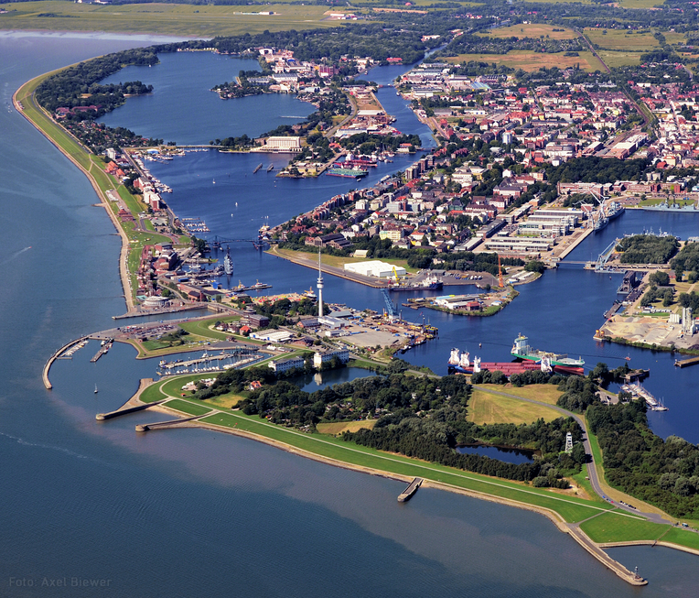
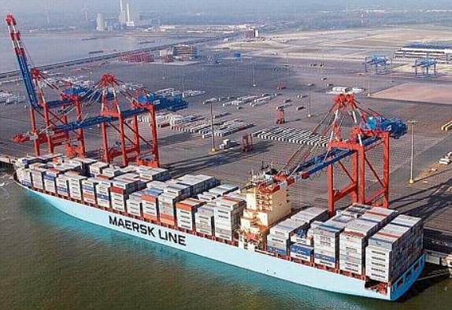
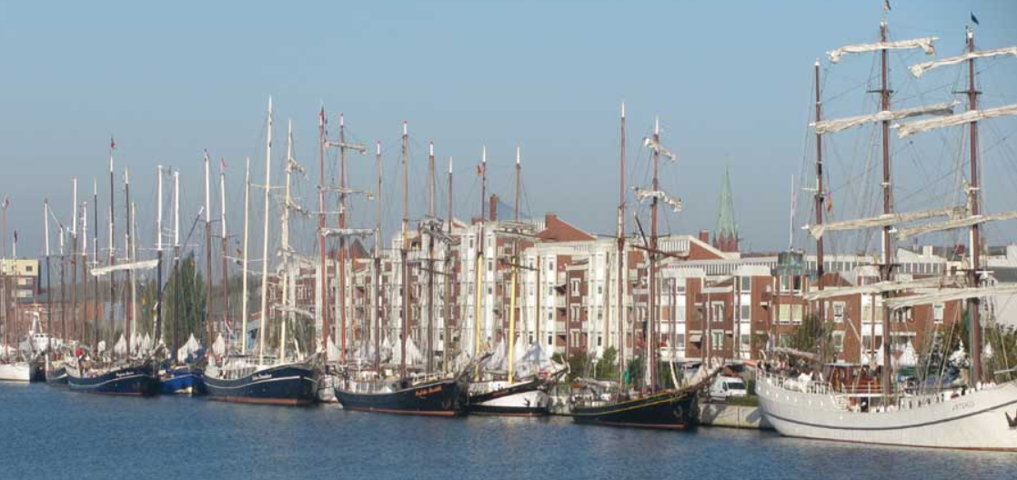
Wilhelmshaven
City at the North Sea
Largest continuous tidal flats in the world!
Lower Saxony Wadden Sea National Park
UNESCO World Heritage since 2009
10
10
10

Slide 11
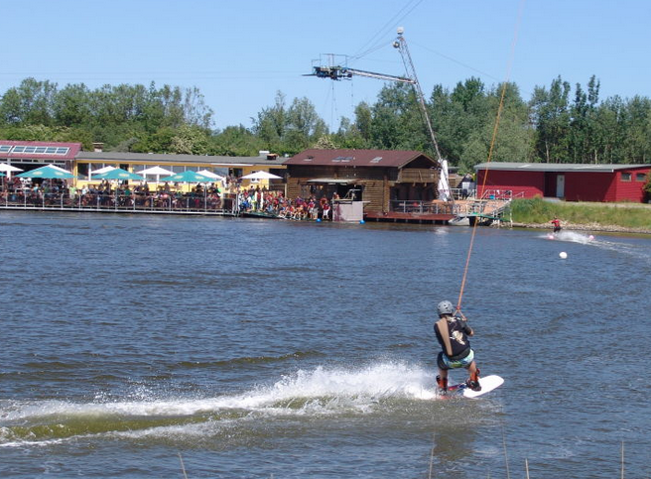
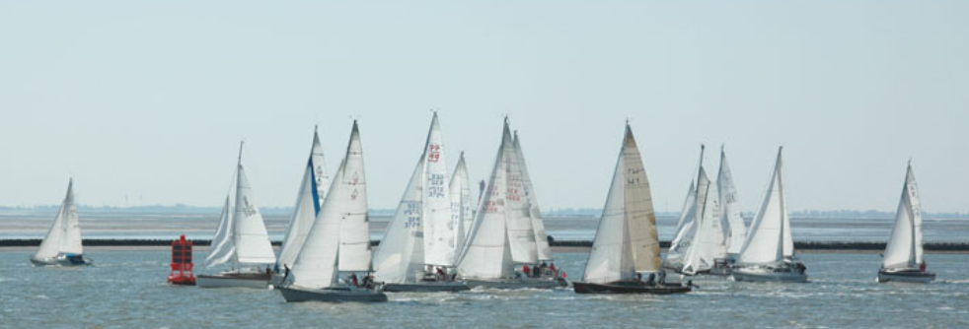
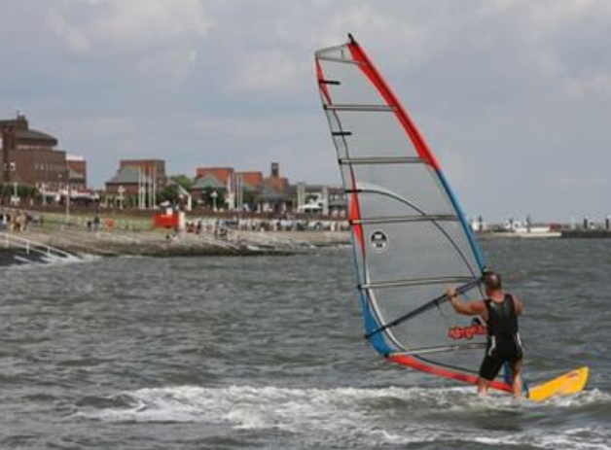
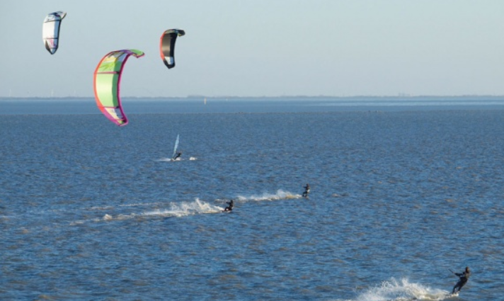
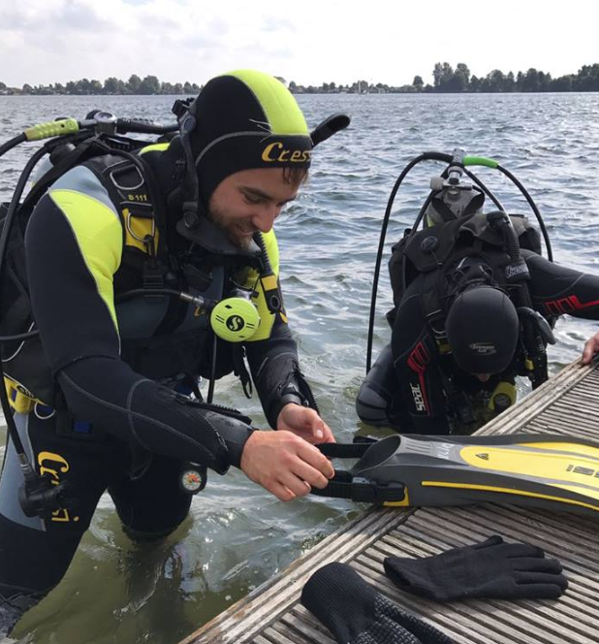
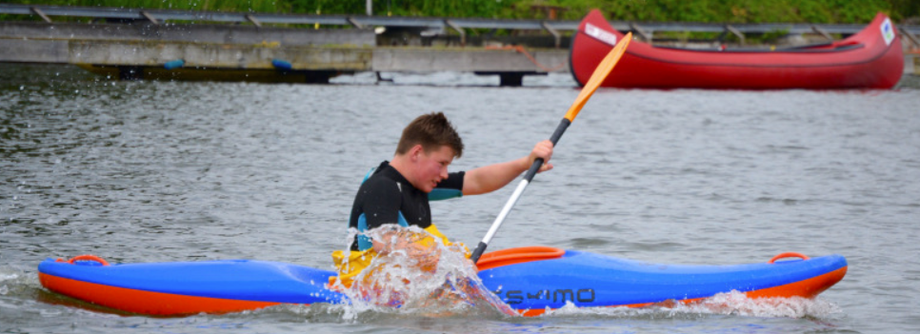
wilhelmshaven
Watersports
Watersports
11
11
11

Slide 12

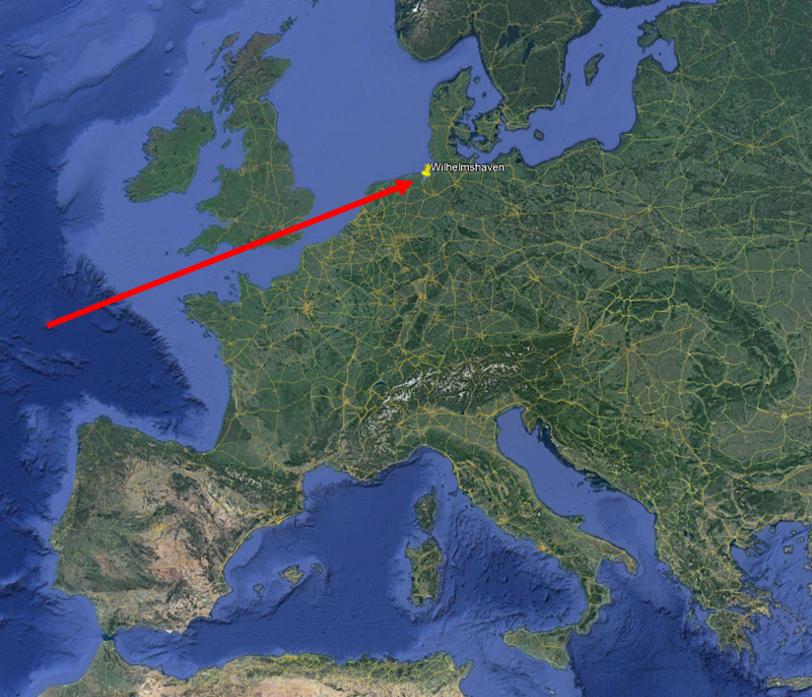
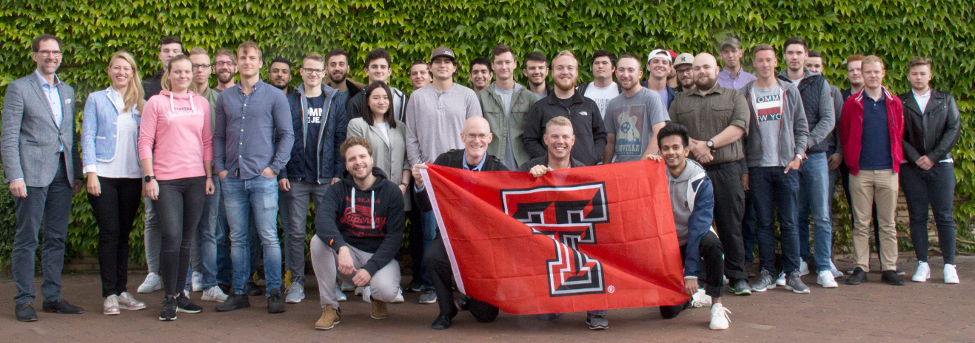
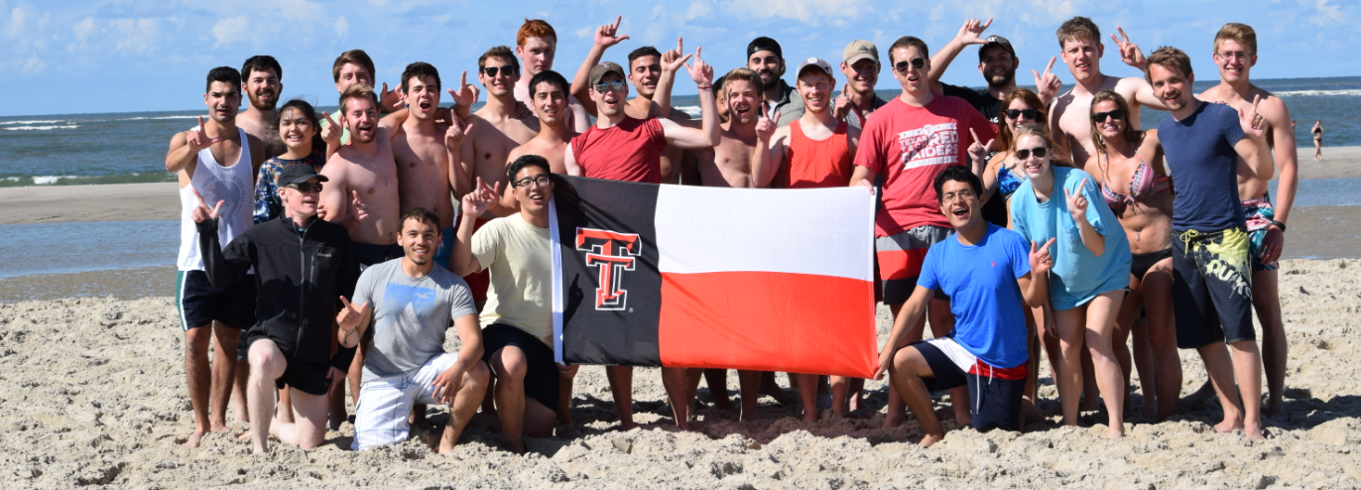
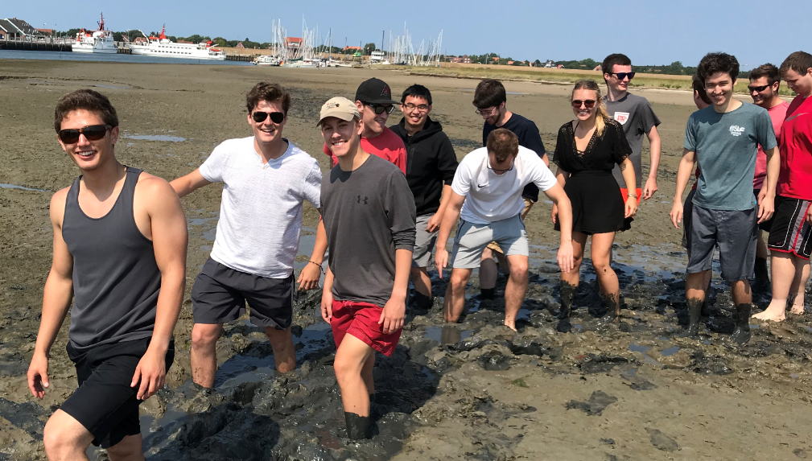
11th Summerprogram 2020 in GERMANY
Cooperation since 1987 – Yearly summerprograms since 2010!
  OFFER IN 2020:
  6 weeks in Germany at Jade - July 6th to August 16th 2020
  3 offered courses:
  Circuits 3 cts (TTU ECE 3302???)
theoretical class – learn the theory
PSPICE simulation – simulate the circuits
verify your simulation, measurements in lab
Fluid Mechanics 3 cts (TTU CE 3305)
basic knowledge of technical fluid mechanics
professional analysis of functionality and interaction
of practice-relevant fluidic problems
International Engineering 3 cts (TTU ENGR 3301)
Part 1: Intercultural Understanding
gain intercultural competencies for global business
Part 2: Innovation Engineering
methods of customer-centric innovation engineering
Costs
  $2.500 housing & breakfast
  $620 program & activities fee
  + TTU fees
Largest continuous tidal flats in the world!
Lower Saxony Wadden Sea National Park
UNESCO World Heritage since 2009
www.jade-hs.de/ttu
12
12
12

Slide 13
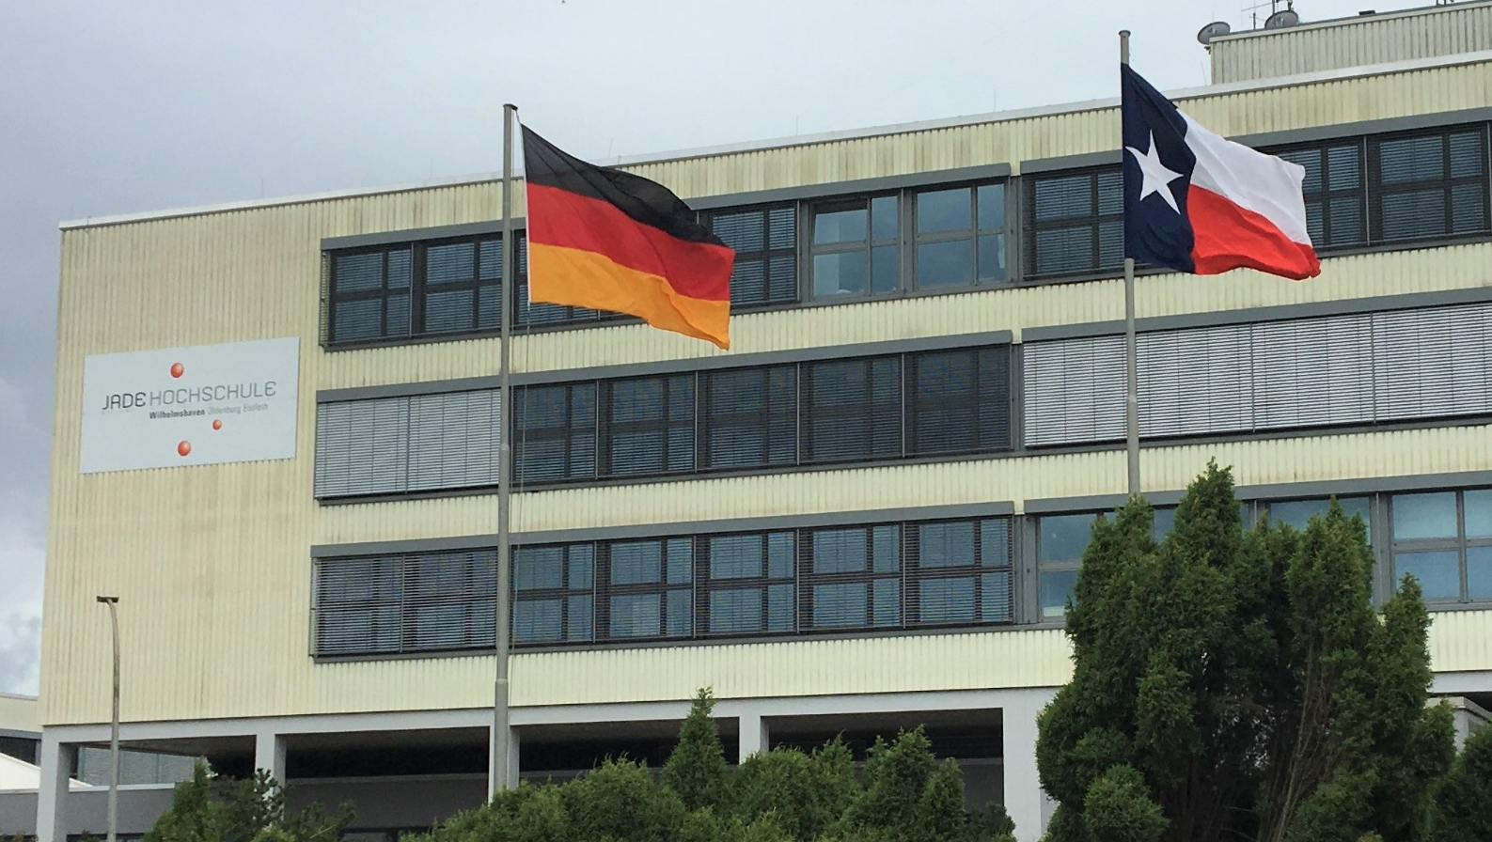
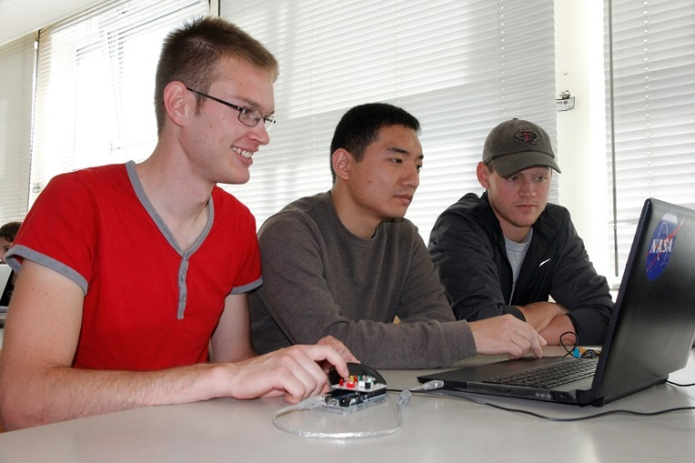
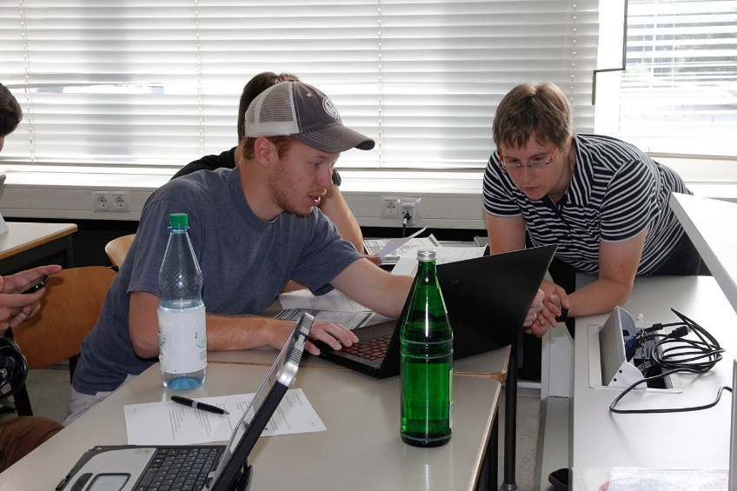
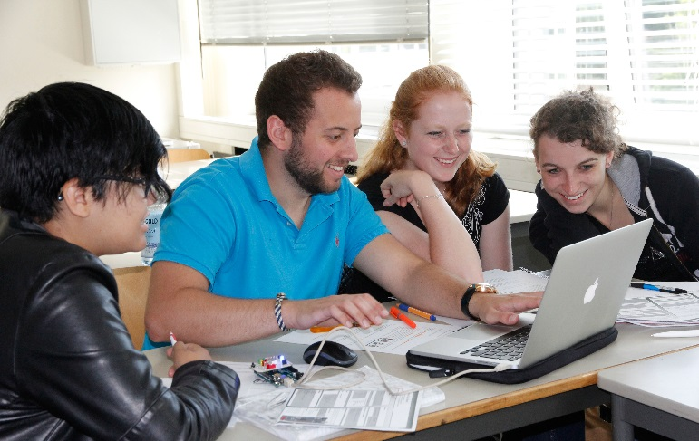
International experience
International experience during group-work in Wilhelmshaven
13
13
13

Slide 14
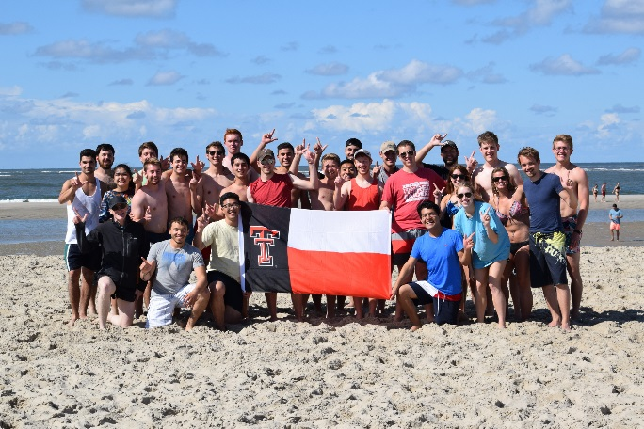
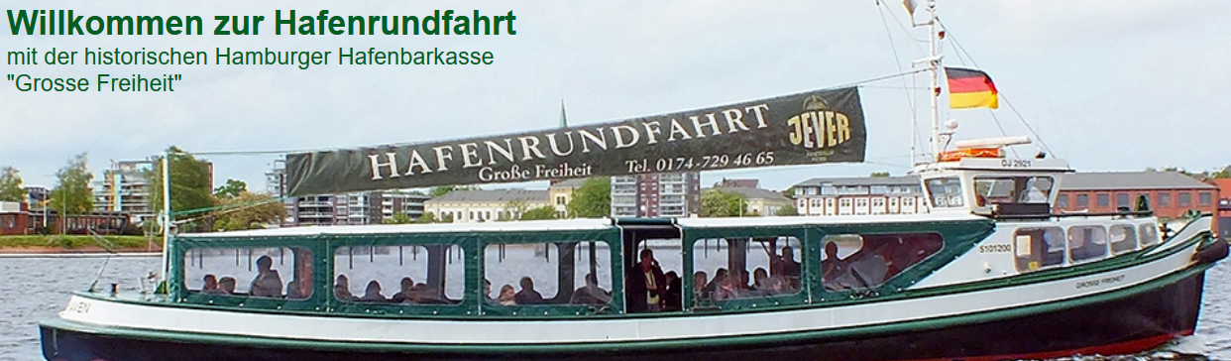
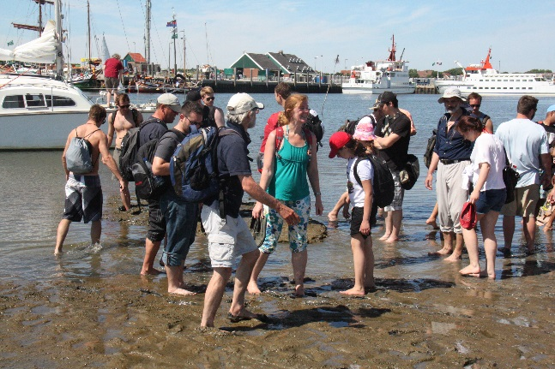
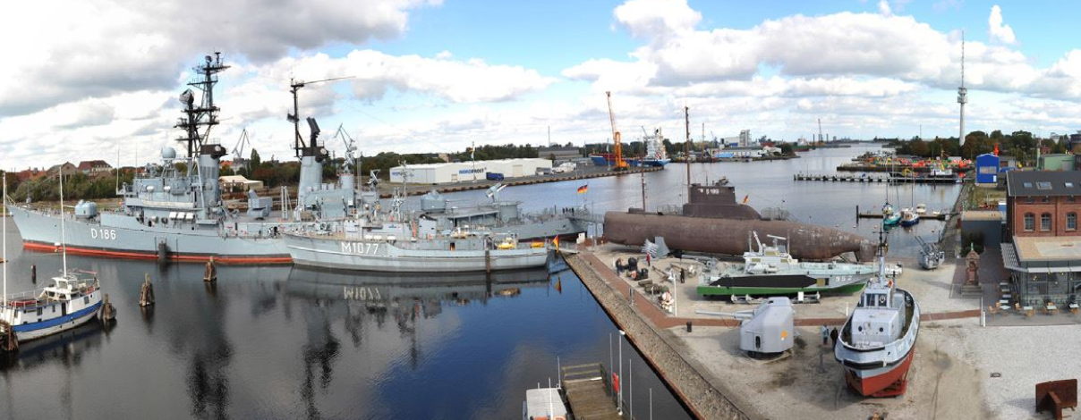
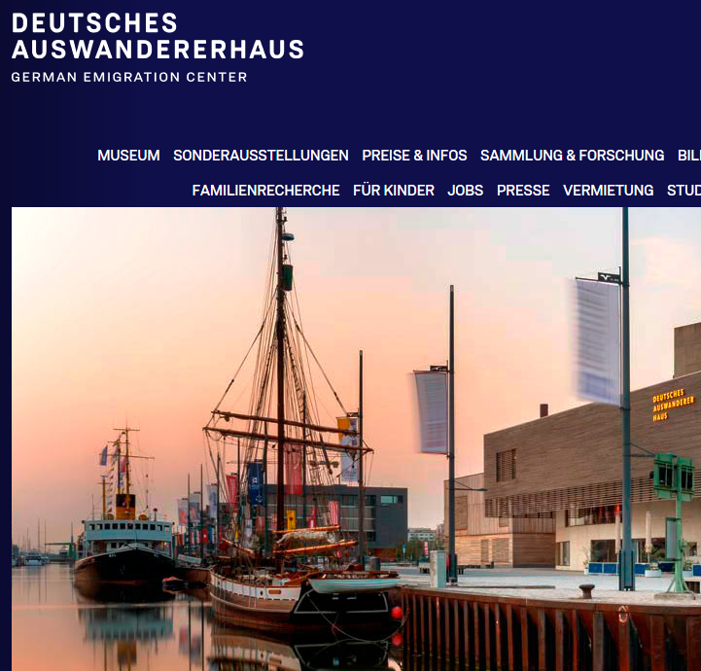
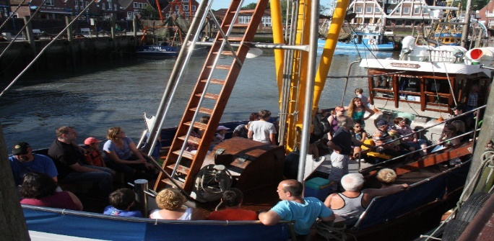
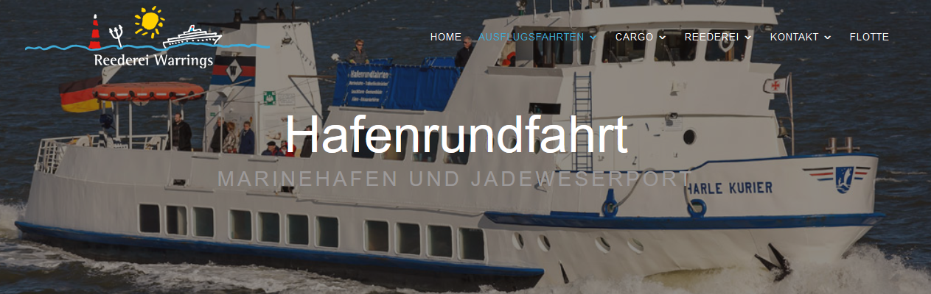
Additional program
Additional program
welcome lunch
guided town walk Wilhelmshaven
sightseeing bus tour Wilhelmshaven
welcome dinner
visit of the German Emigration Center Bremerhaven
volleyball with dinner
Spiekeroog island daytrip - World Heritage Wadden Sea
inner/outer harbor roundtrip
visit of the German Navy museum
final barbeque
Having fun.
14
14
14

Slide 15
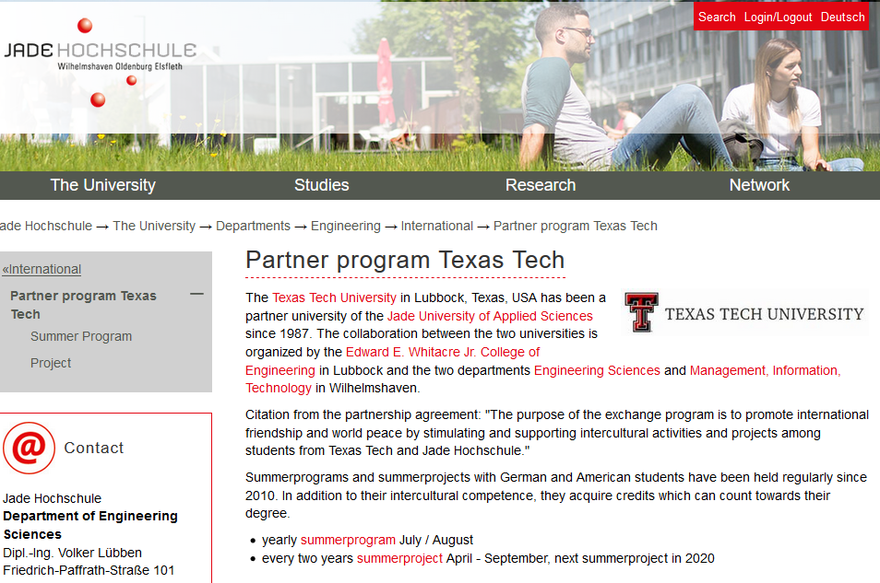
WEBSITE
Visit Germany Wilhelmshaven!
www.jade-hs.de/ttu
15
15
15

